Slide 1
Serverless ASP.NET Core
in AWS
Garo Yeriazarian, Software Whisperer

Slide 2




About Garo Yeriazarian
SOFTWARE WHISPERER
~18 years in the business (more or less)
Helping people solve problems
MANAGER, LEADER, FUNGI
Spreading mirth and merriment and software
Resolving conflict, finding a better way
HOUSTONIAN
BS CS and MBA from University of Houston
Involved with various software communities
President, Houston .NET Users Group
@garoyeri
https://headspring.com/author/garabed-yeriazarian/ https://garoyeri.dev
Icons made by www.flaticon.com/authors/freepik Freepik from www.flaticon.com
Icons made by www.flaticon.com/authors/dave-gandy from www.flaticon.com

Slide 3

What is Serverless?

Slide 4

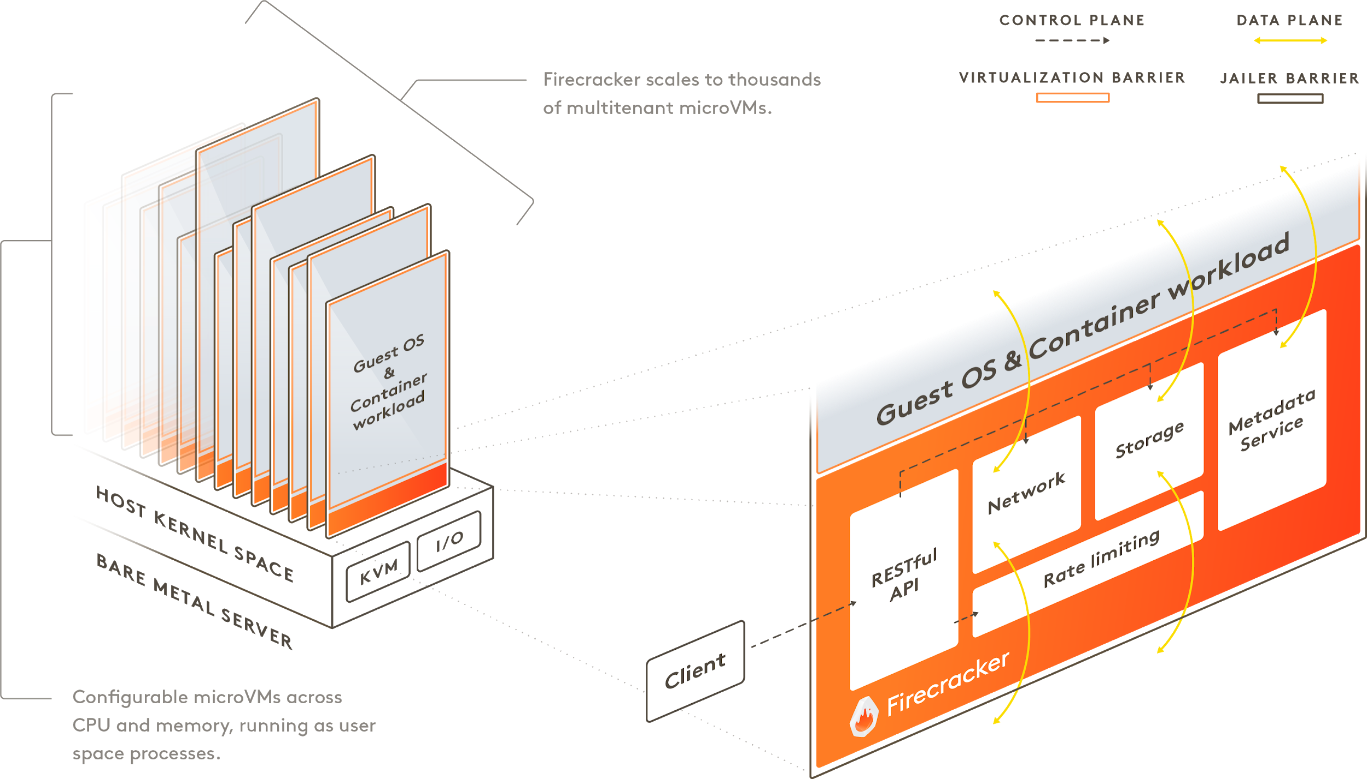
https://firecracker-microvm.github.io/

Slide 5
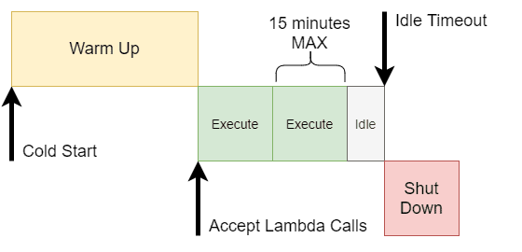
AWS Lambda Lifecycle

Slide 6
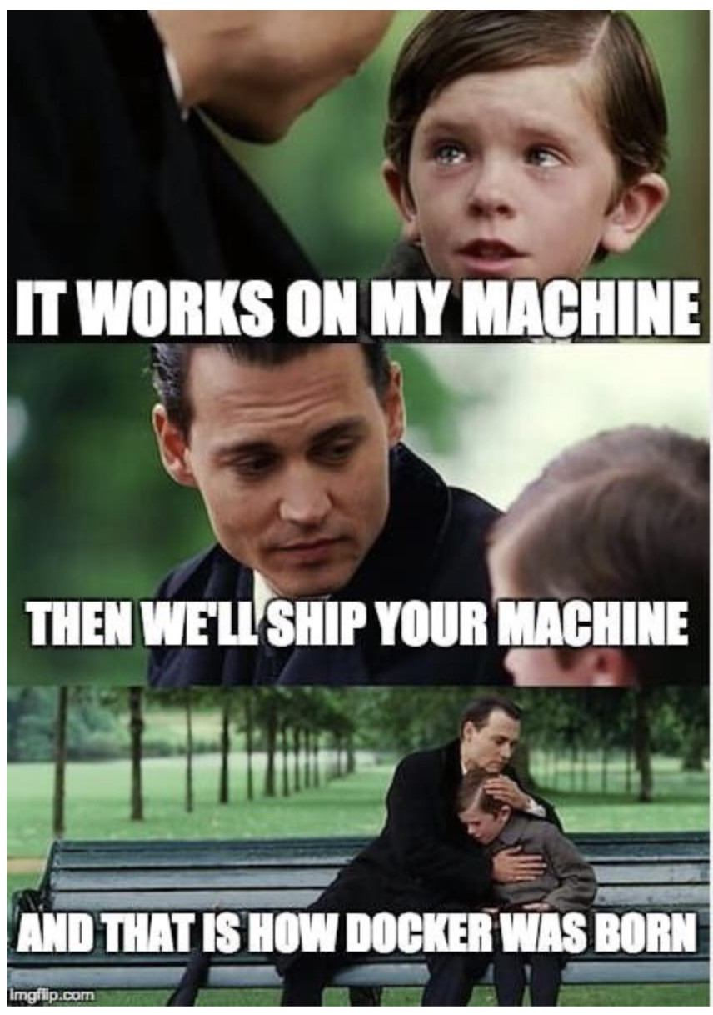

Slide 7

AWS Services Core Components
Compute
Network
Storage
Permissions

Slide 8
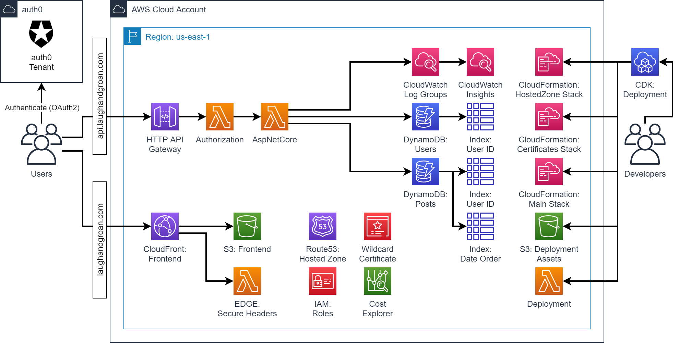

Slide 9

Demolition

Slide 10
The Easy Parts

Slide 11
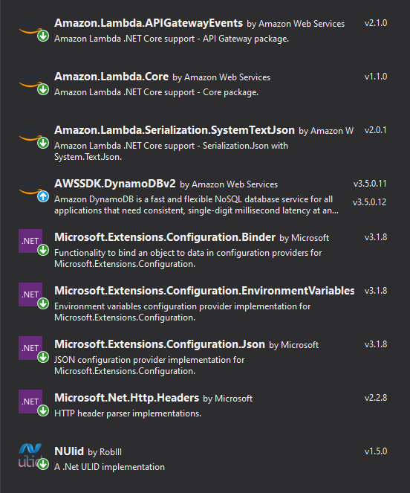
AWS Lambda in C#
STRONGLY TYPED REQUESTS / RESPONSES
Use the NuGet packages (left) to easily handle AWS protocol
Libraries have similar patterns (they are generated from the protocol specification)
INCLUDE ONLY AS MUCH AS YOU NEED
Libraries are modular, keep your code size small
LAMBDA ENTRY POINT IS JUST A METHOD
A Lambda can be any method on any class
The runtime will create the class (cold start)
One call happens at a time
Initialization is saved between runs (warm start)

Slide 12
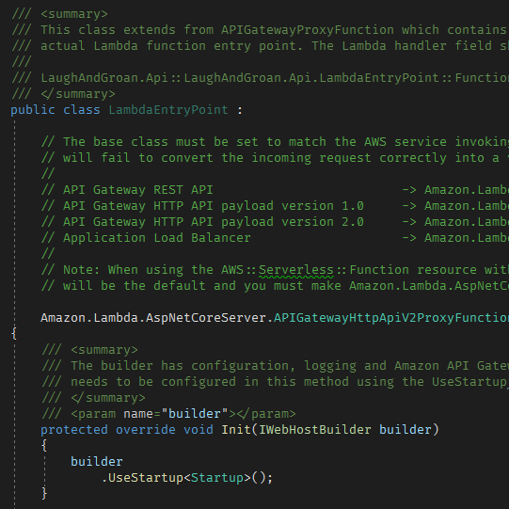
ASP.NET Core in Lambda
OUT OF THE BOX TEMPLATE
Use the AWS provided templates to get started
WORK IN FAMILIAR ASP.NET CORE MODEL
The application is still a “regular” ASP.NET Core application that you can run and test locally and then deploy to Lambda
DEPLOY SAME CODE AS CONTAINER TO ECS
Because the template contains both a Lambda entry point and a local entry point, the same project can be deployed either as a container to ECS (or another container orchestrator) without any code changes

Slide 13
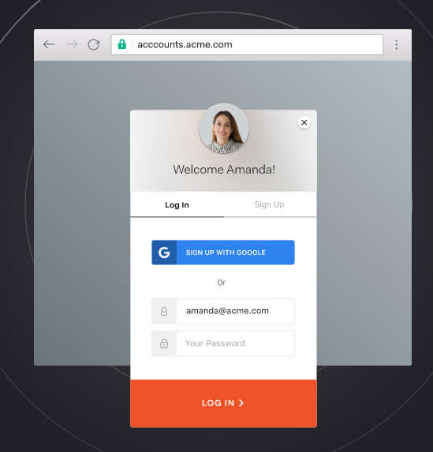
Authentication using Auth0 (not Cognito)
GREAT OUT OF BOX EXPERIENCE
Maximum Authentication for Minimum Effort
Guides you through the configuration
GENEROUS FREE TIER
7000 users, 2 social login connections
Create multiple tenants
AUTHENTICATION IS HARD
Getting authentication and authorization right is challenging, don’t do it on your own!
How to choose the best identity management solution (Hint: don’t build it yourself) - Headspring

Slide 14

AWS Cloud Development Kit
TYPESCRIPT!
CDK supports it the most, easier to include other constructs
Publish your reusable parts on NPM
Intellisense / Code Completion is usually quite good
Definitely easier than slinging YAML
Better IDE support than Terraform
BASED ON CLOUDFORMATION
Uses the AWS built-in technology for deployment
Easier to setup and get running: cdk bootstrap (just needs a bucket)
CLI
Easy CLI for running deployments: npm install -g cdk

Slide 15
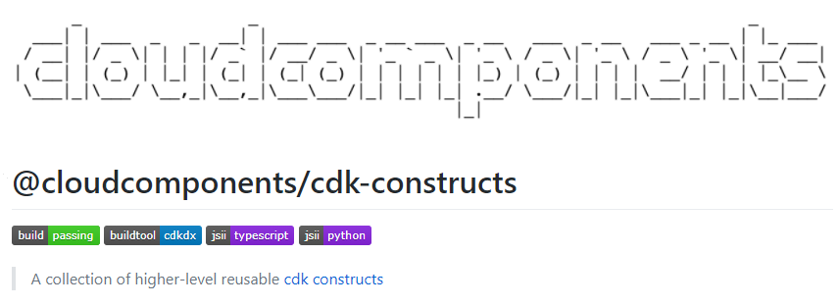
Static Website Hosting
REUSE EXISTING PATTERN
S3 => CloudFront + Lambda @ EDGE
Customize the domain name, upload the code
SECURE HEADERS
Check your site against: https://securityheaders.com/
CloudFront doesn’t do this by default
Use Lambda@EDGE to adjust headers
(Consider moving to CloudFront Functions)
REDUCE OPERATIONAL COSTS
The SPA doesn’t change too often, serve from cache

Slide 16

Universally Unique Lexicographically Sortable Identifier
SORTABLE GUIDS
Includes a time component and a random component, giving you the power of GUID but lexicographically sortable!
EXTRACT TIMESTAMP
Using it for the Post IDs, includes the timestamp component already, plus uniqueness
Sortable in the database by using an index
EASY NUGET LIBRARY
Nuget: NUlid
Use the MonotonicRng to guarantee sort order
https://github.com/RobThree/NUlid
01AN4Z07BY 79KA1307SR9X4MV3
|----------| |----------------|
Timestamp Randomness
48bits 80bits

Slide 17

The HARD Parts

Slide 18
AWS Cloud Development Kit
BRITTLE PROJECTS
TypeScript projects are picky about versions (pin all @aws-cdk to same version to avoid headache and weird error messages)
Hard to debug the node graph
(This is improving with CDK 2.0 which has a unified package)
EXPERIMENTAL API SURFACE
Some of the nicer Constructs are tagged as “Experimental”
“Experimental” APIs do NOT follow semantic versioning and can break
CDK development is fast and loose
MULTI-LANGUAGE SUPPORT (SORT OF)
Supports other languages (Python, C#, Java), but not as well as TypeScript
Most sharing is done as Python or TypeScript

Slide 19
Lambda Cold Starts
ASP.NET CORE STARTUP CAN BE EXPENSIVE
EF Core has a high startup cost due to code generation (this will be fixed in EF Core 6 with models generated at compile time)
Microsoft.Extensions.Hosting can use a lot of reflection
LAMBDA SERVES REQUEST ONE AT A TIME
A single Lambda will serve one ASP.NET request at a time. Requests will either get queued or will spin up a new instance. This is under AWS control, but you can tune it a little
LATENCY DURING COLD STARTS
A user that gets caught in a cold start could see a few seconds of delay before the application can serve the request, optimize startup time to avoid this

Slide 20

AWS API Gateway
SPLIT CHOICES: “REST API” (v1) OR “HTTP API” (v2)
Documentation offers both options, different caveats
V1: More brittle, more customizable features
V2: Simpler, more focused on HTTP API and Websocket
CORS IS HARD TO GET RIGHT (DOCS ISSUE)
CORS is important to have, but setting it up is not clear
Allow these Headers:
"Content-Type", "X-Amz-Date", "Authorization",
"X-Api-Key", "X-Amz-Security-Token", "X-Amz-User-Agent"
Pick the origin
Ended up disabling API Gateway CORS in favor of ASP.NET CORS
OPERATIONAL CHALLENGES
Troubleshooting can be challenging, logs are harder to go through
Documentation can be hot garbage

Slide 21

Getting to know DynamoDB
DON’T TREAT IT LIKE A RDBMS
DynamoDB has very specific requirements (like most NoSQL databases)
If you run it like a relational database, you’ll have a bad time
TRY AND TRY AGAIN
Read lots of documentation
Look at LOTS of examples
Get it wrong
Epiphany of understanding!
STILL GET IT WRONG.
OPERATIONAL CHALLENGES
Provisioning read and write, monitor usage and see how it works

Slide 22
Questions
Comments
Queries
Concerns?

Slide 23
Helpful Links
LOCAL LAMBDA DEBUGGING (thanks Robyn!)
https://docs.aws.amazon.com/serverless-application-model/latest/developerguide/serverless-sam-cli-using-debugging.html
SETUP LOCAL AWS SERVICES
https://github.com/localstack/localstack

Slide 24

Source Code, Examples, Follow Up
SOURCE CODE
It’s on GitHub here:
https://github.com/garoyeri/laugh-and-groan
(more documentation and blog posts to come)
PRESENTATION
This presentation will end up on the repo in GitHub too, and some articles on my website:
https://garoyeri.dev
REACH OUT
Hit me up, I’d love to talk about all this stuff!
@garoyeri
https://headspring.com/author/garabed-yeriazarian/ https://garoyeri.dev
Icons made by www.flaticon.com/authors/freepik Freepik from www.flaticon.com
Icons made by www.flaticon.com/authors/dave-gandy from www.flaticon.com

